Slide 1

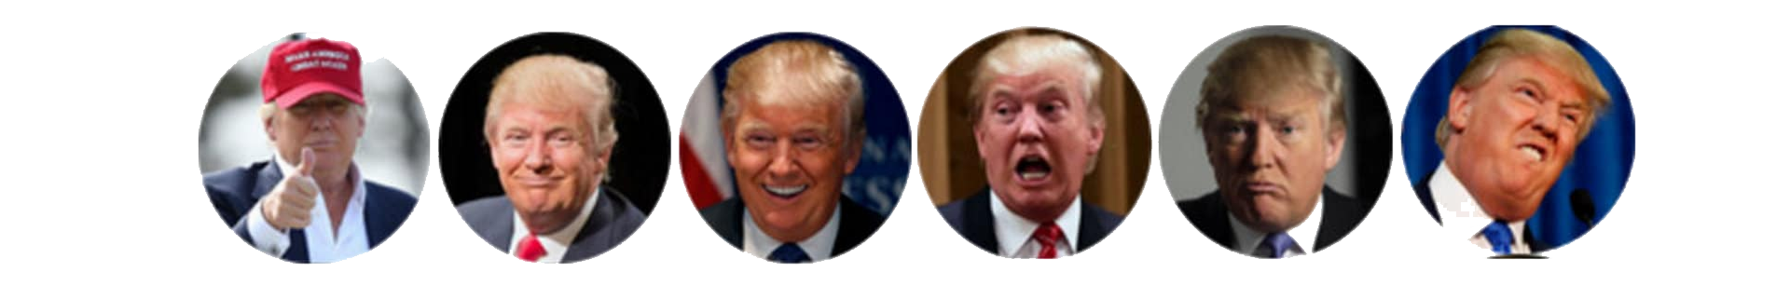
Moods
An android project exclusively designed for students
Étienne Bérubé, CEO
William Perron-Lafleur, COO
Amir Osman, Janitor

Slide 2






Storyline
Moods

Slide 4
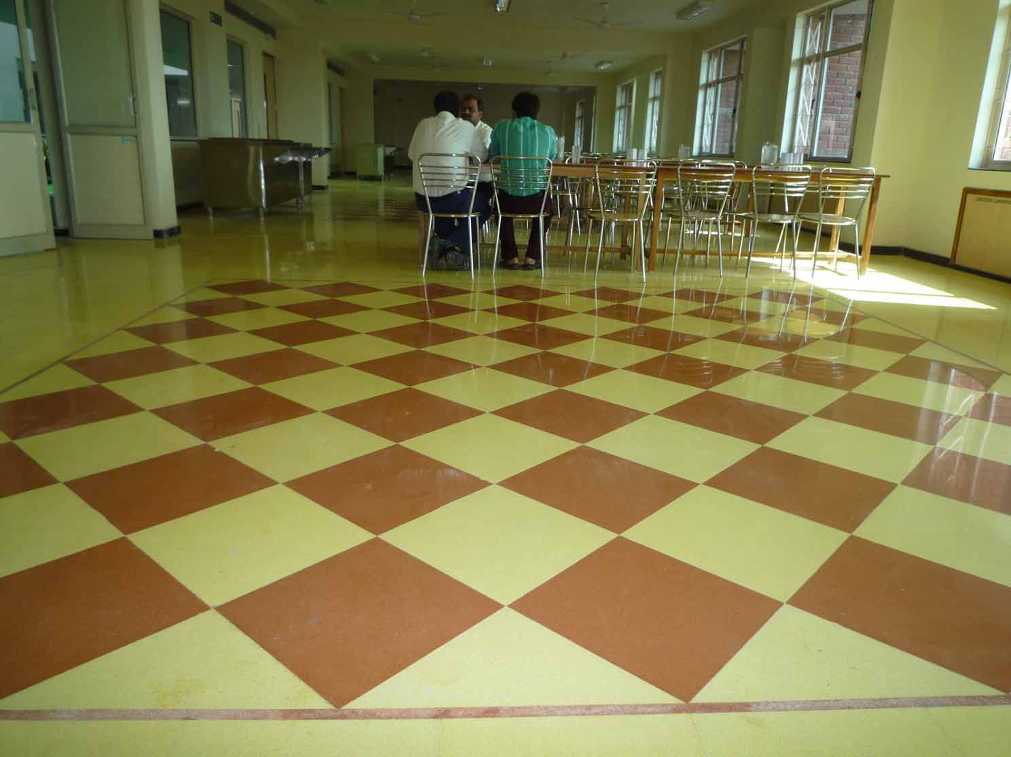
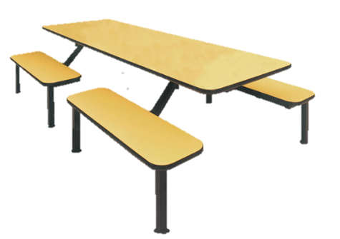



Slide 5
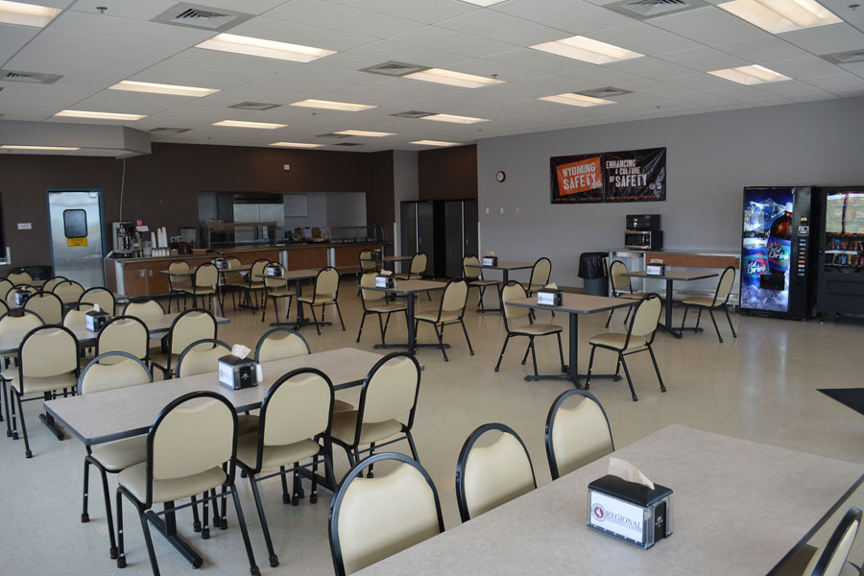



Slide 6


Slide 7


Slide 8
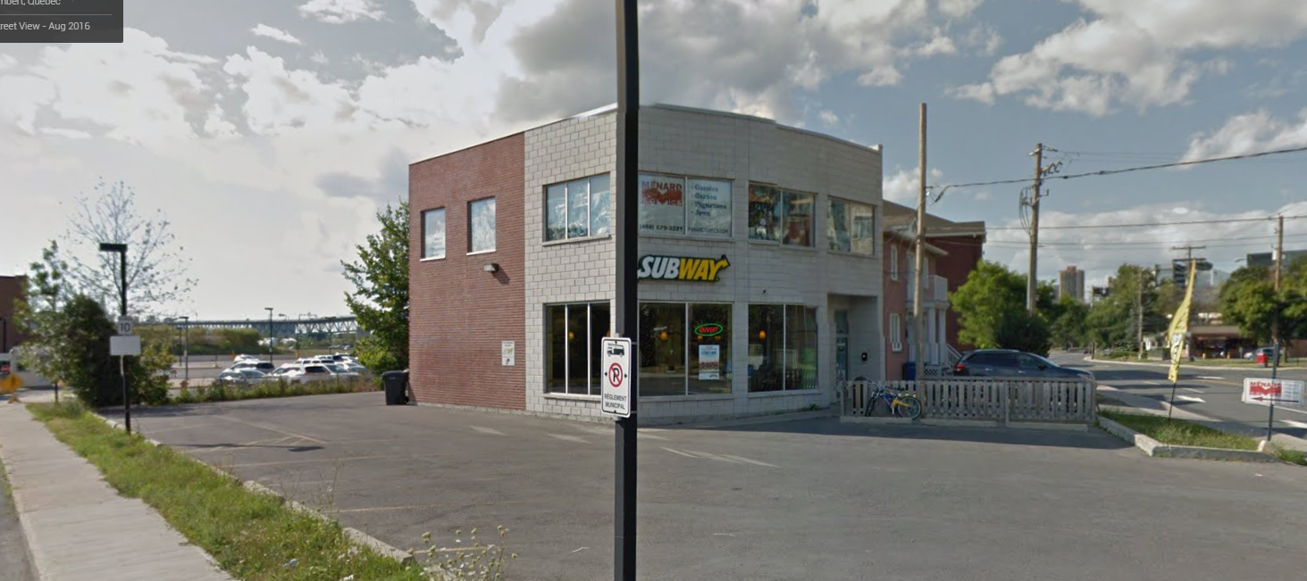

Slide 9
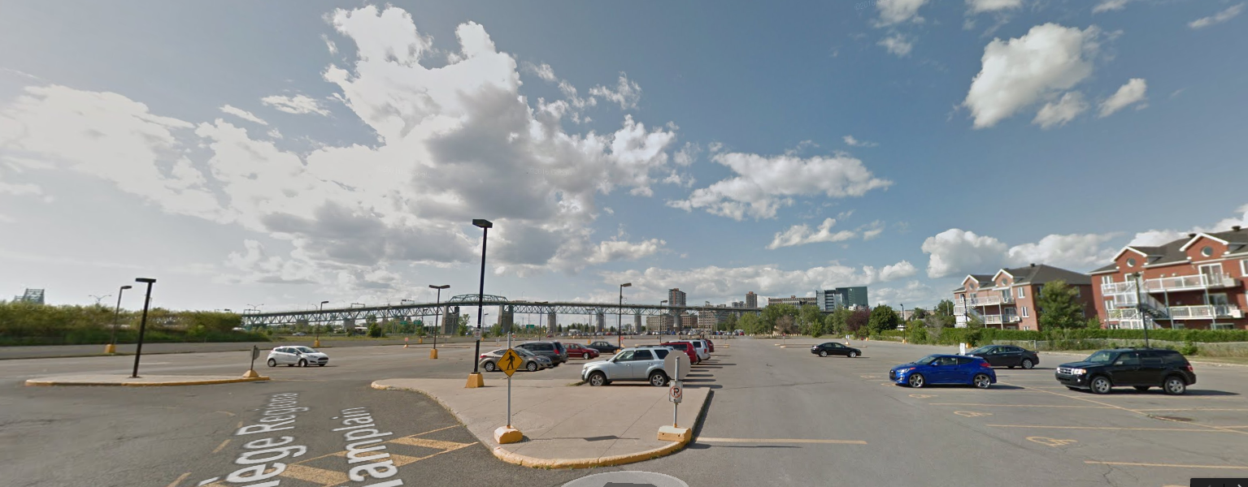

Slide 10

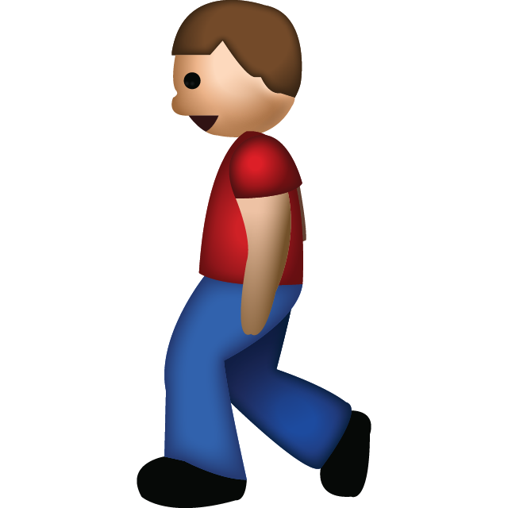
outcome
Students → often UNABLE to be with the RIGHT people to do what they WANT
General experience at school NEGATIVE and SOCIALLY LACKING
Moods

Slide 11









PROBLEM
Lack of communication between students
Inaccessibility to key information
Moods

Slide 12
Solution & features
Ability to have student USER PROFILE
SHARE your status/mood
LOCATE your peers (FusedLocation Triangulation API)
SEND a ‘Poke’ to your friends (Request)
Add & ACCESS other FRIENDS’ PROFILE
Database to STORE & RETRIEVE information easily
Be USER-FRIENDLY
Moods

Slide 13
Algorithms
Moods

Slide 14

Algorithms
Sort
Insertion Sort
Big O notation
Worst Case: O(n²)
Best Case: O(n²)
Average: O(n²)
Search
Binary search
Big O notation
Worst Case: O(log n)
Best Case: O(1)
Average: O(log n)
Moods

Slide 15
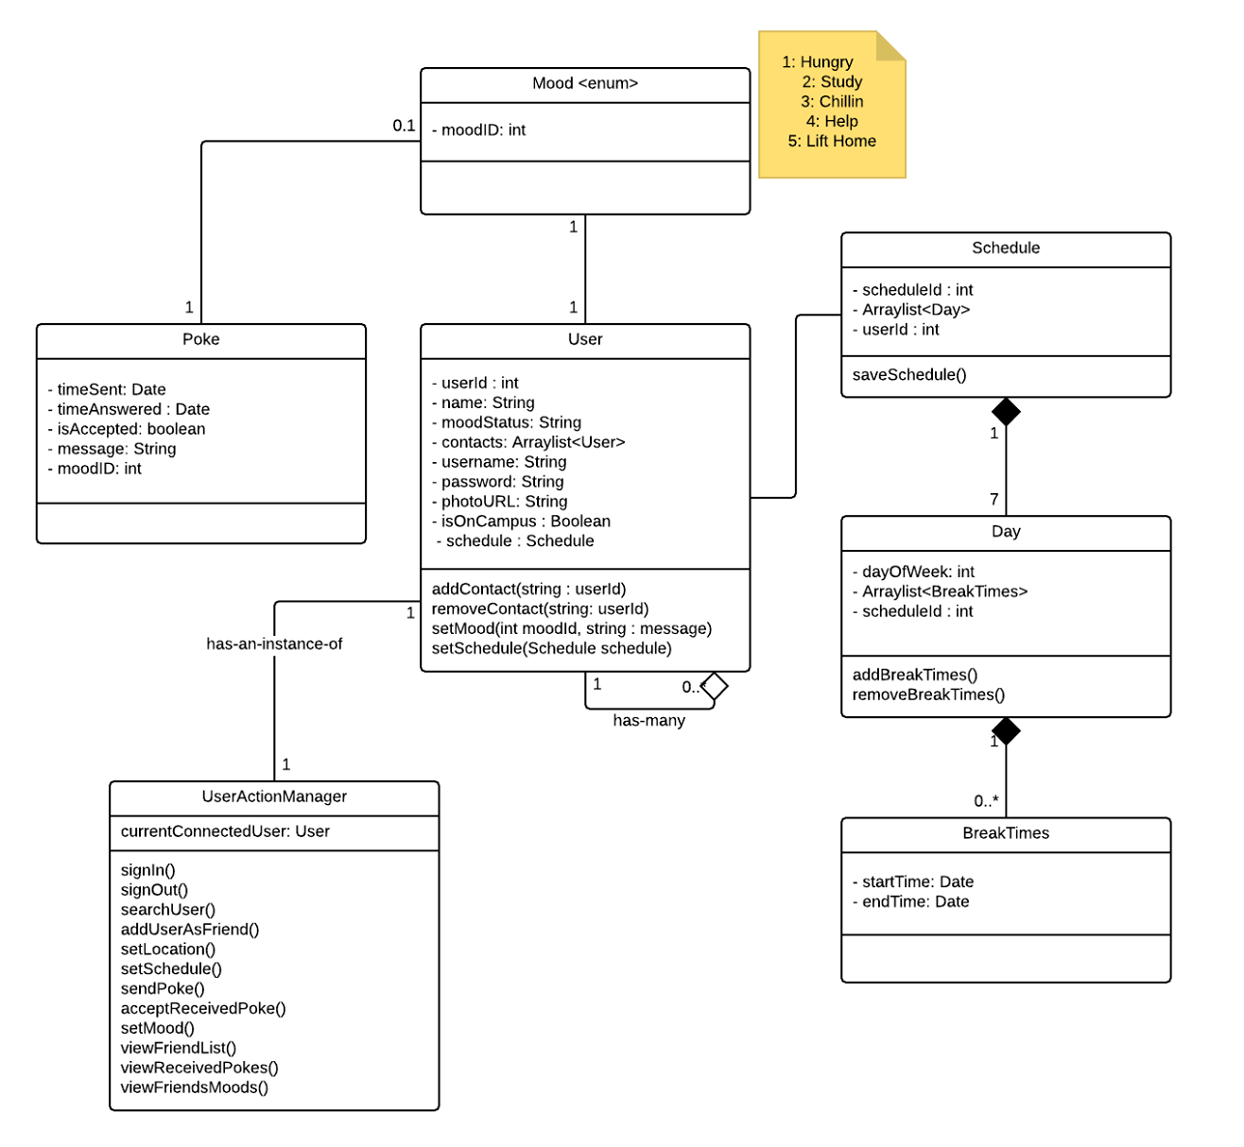
DESIGN

Slide 17
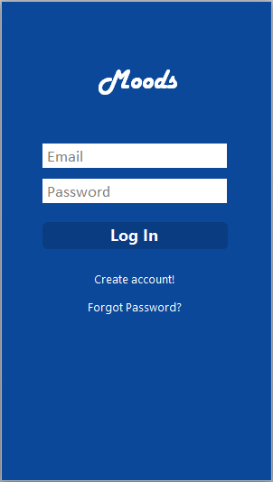
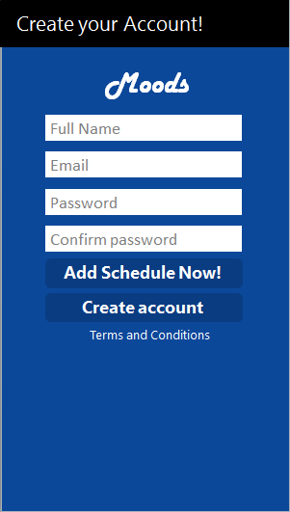
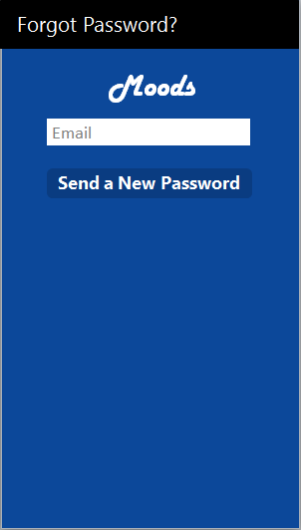
Gui
Login Create Account Forgot credentials
Moods

Slide 18

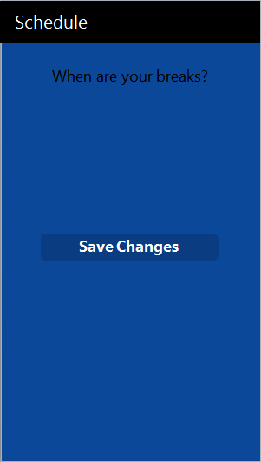

Loading Schedule Terms & Conditions
Moods

Slide 19
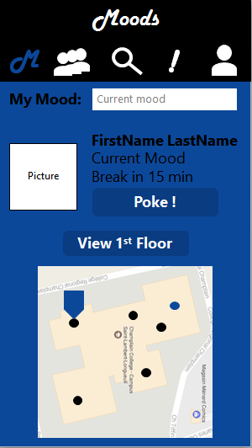
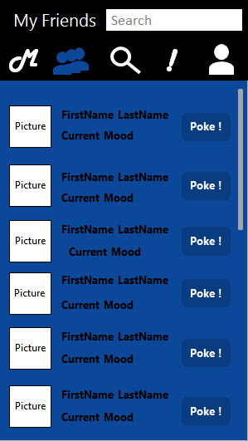
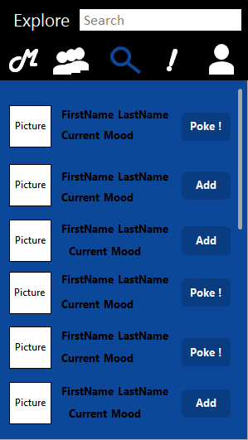
Home Page My contacts/friends Explore
Moods

Slide 20
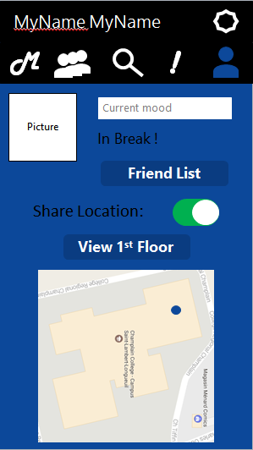
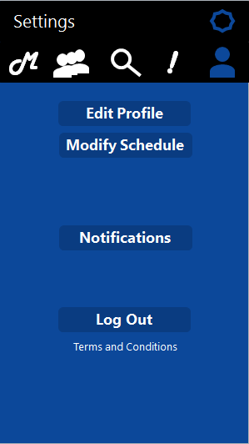
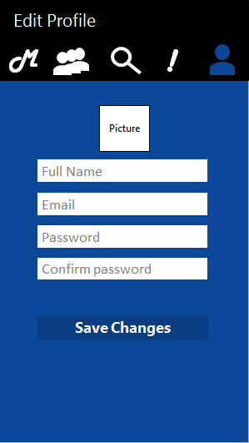
My Profile Settings Edit My Profile
Moods

Slide 21
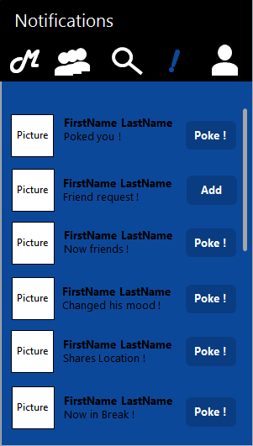
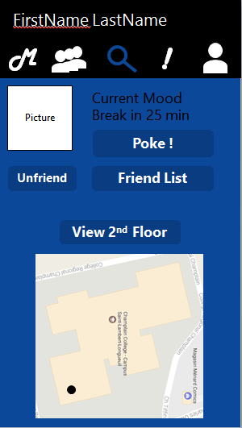
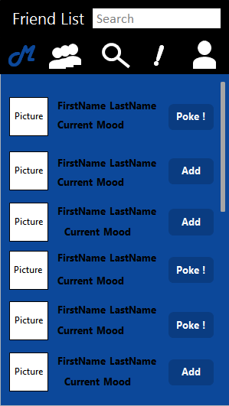
My Profile Friend’s profile Friend’s Friend List
Moods

Slide 22
CONCLUSION
Moods
Moods

